Slide 1
DATA SCIENCE SEMINAR
DOES IT PAY TO BE GOOD
ANALYSIS BY: DHRUV, KESHAV AND AKSHAY

Slide 2


We hope to answer the question with data -
Does Chicago PD reward their good police officers?
We categorized police officers as “good/bad” with a custom defined complaint severity score (CSS). A threshold would be decided based on the distribution of this vector for all officers to determine who would be considered a “good” police officer.
We look at different components that comprise “rewards” for an officer. These include salary and awards that are available to us through the CPDB.

Slide 3

CSS Metric
We compute a metric which we call ‘Complaint Severity Score’ or CSS based on the average annual complaints of an officer multiplied by custom defined weights based on the complaint category.
The weights are defined based on research by our previous cohort and ranges between 0 - 43

Slide 4

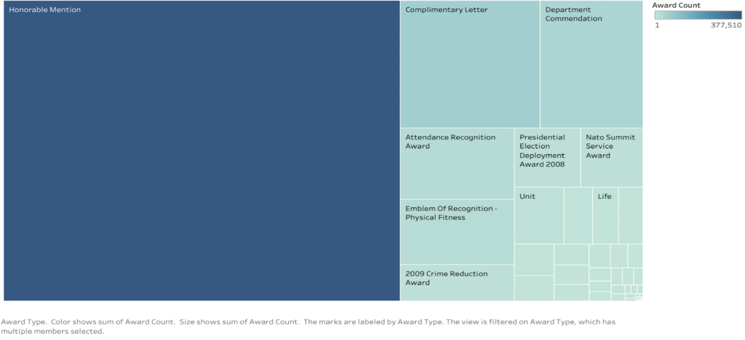
Reward Category Counts - TREEMAP

Slide 5

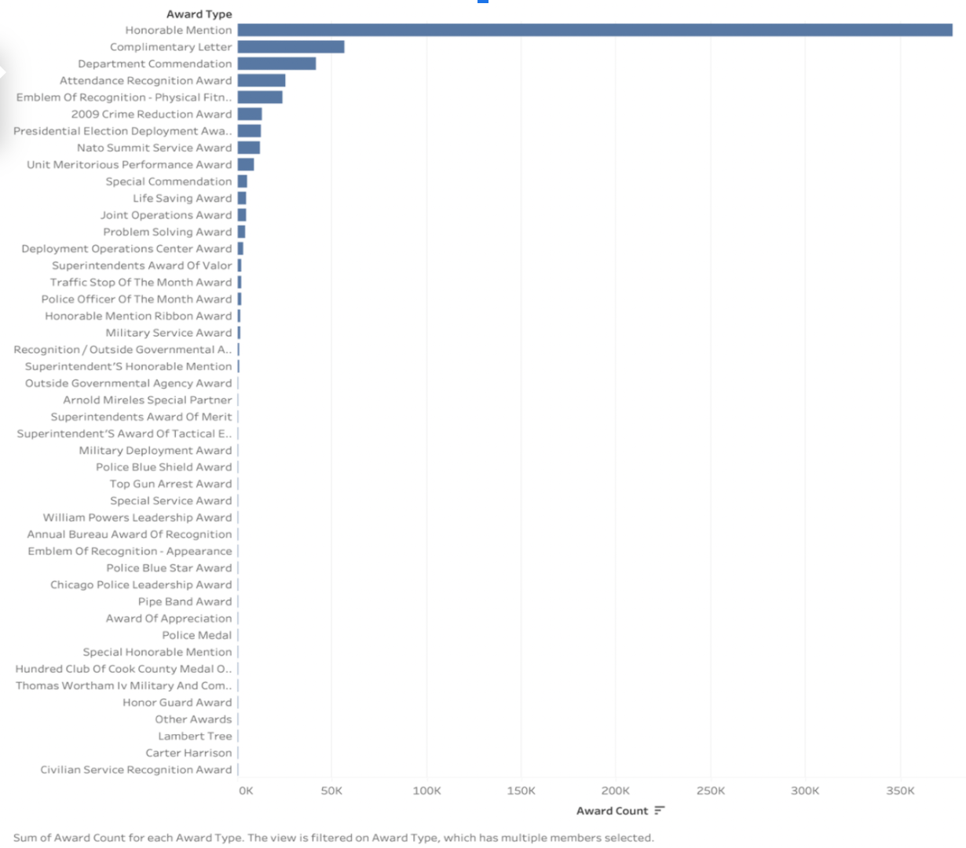
Reward Category Counts - Horizontal Bar Graph

Slide 6
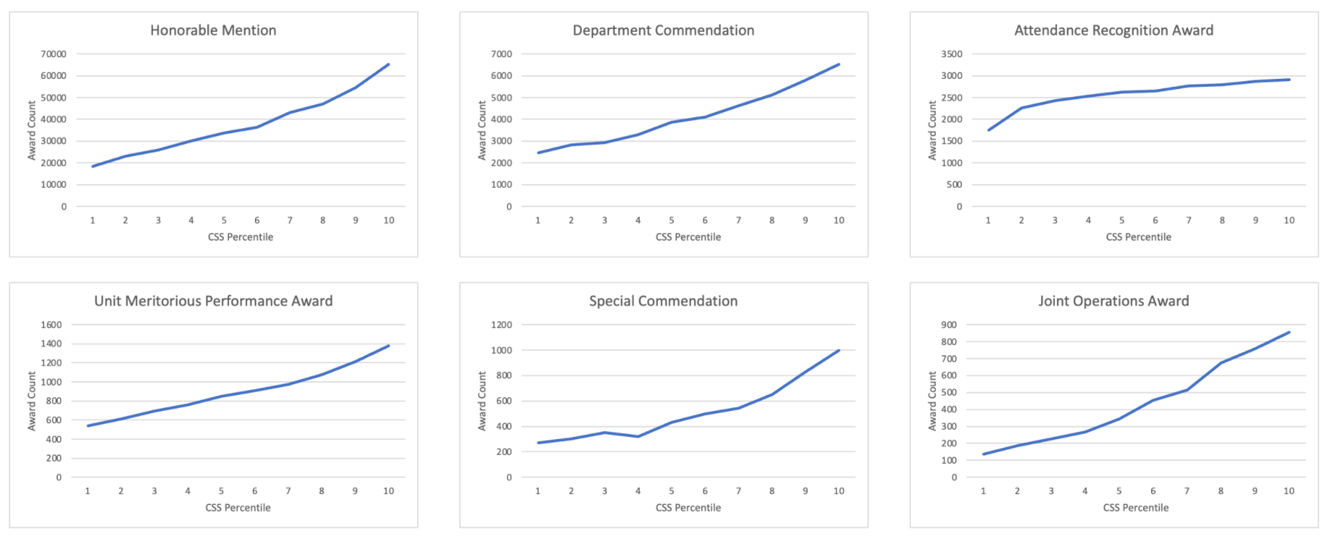
Relationship of CSS and Awards

Slide 7
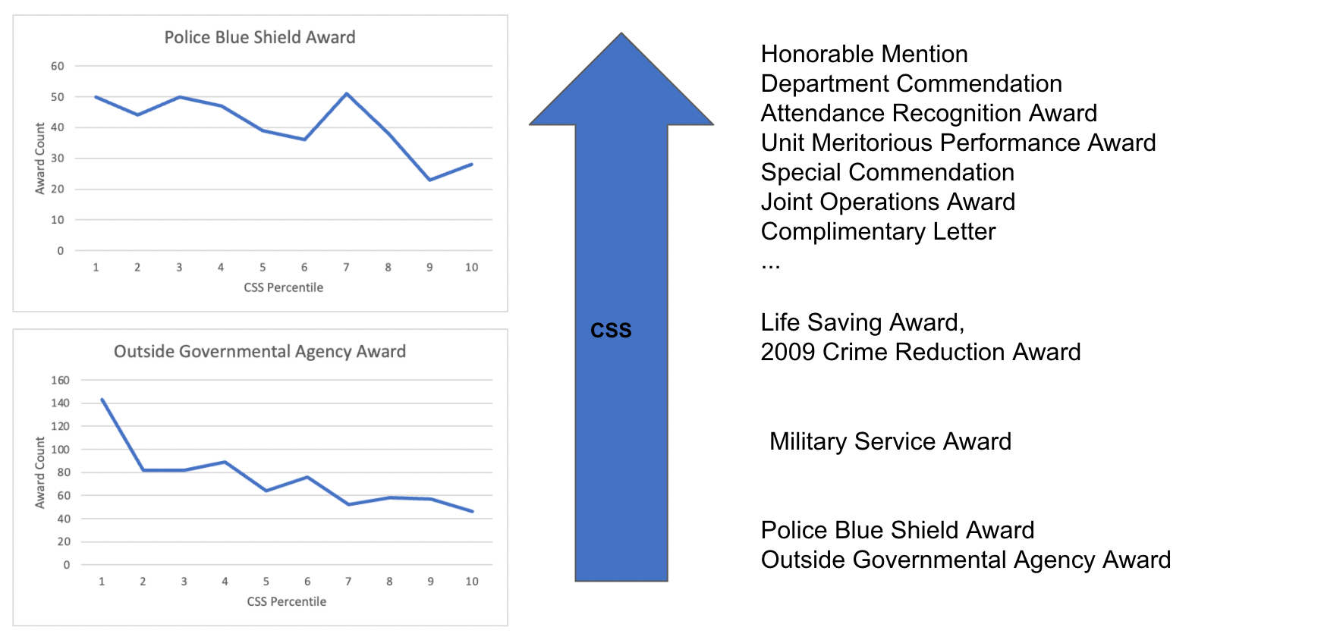
Relationship of CSS and Awards

Slide 8
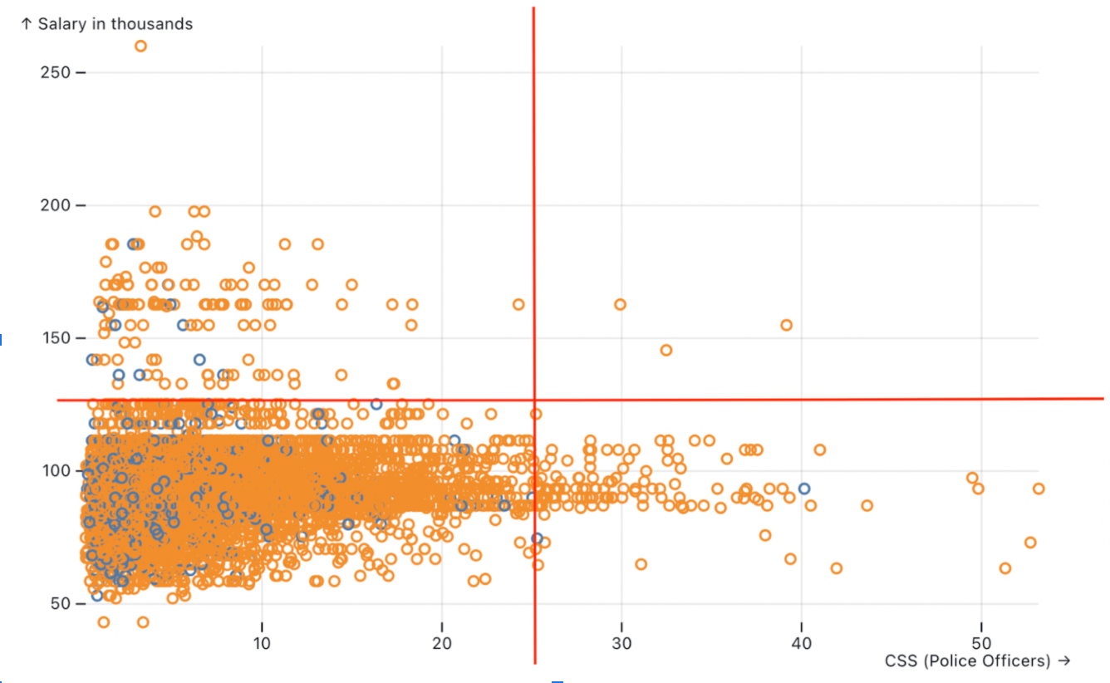
Relationship between CSS and Salary of Police Officers
It is interesting to note that majority of officers with a high CSS metric have a salary less than $100K.
It is also good to see only 3 officers in the 1st quadrant with high CSS and high salary

Slide 9
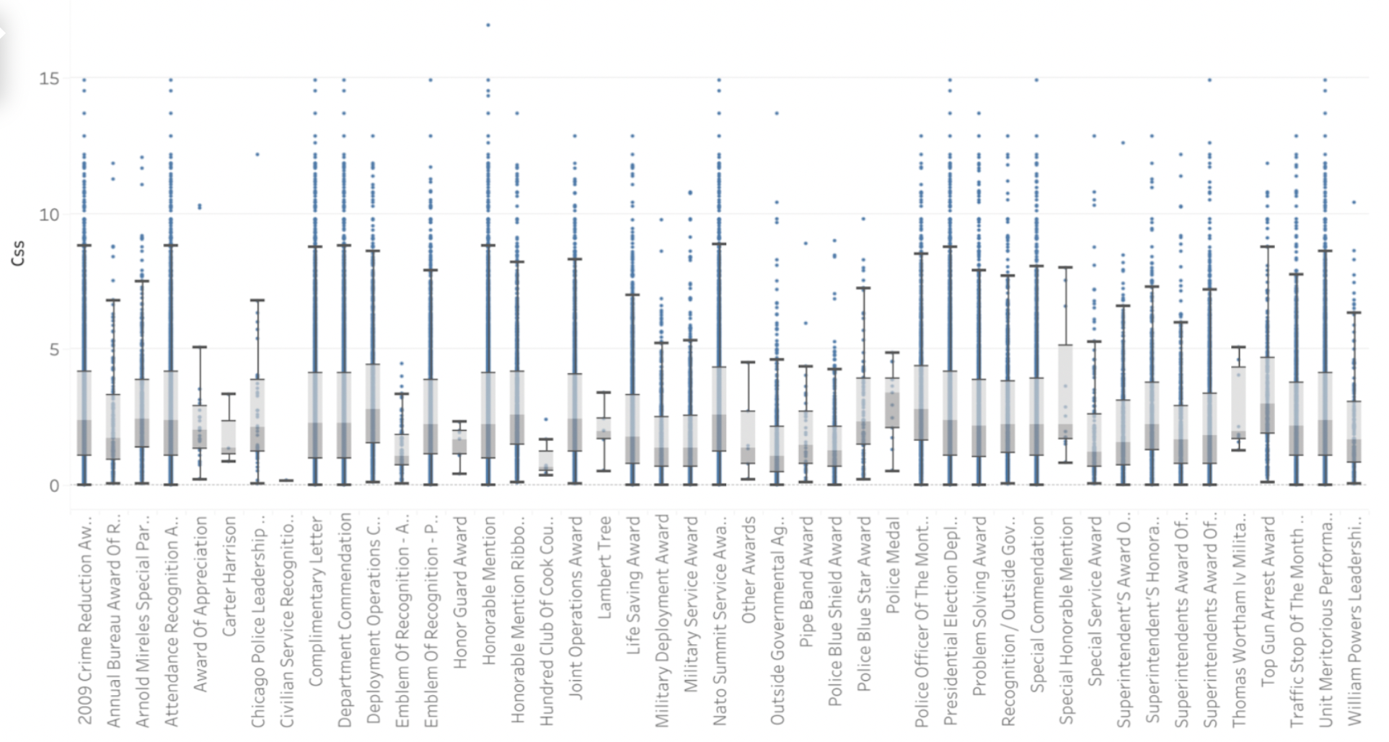
Award Type

Slide 10

We display the relationship between reward categories and average CSS of officers through a box and whisker plot, which allows us to visualize the variance between each category while also showing us the outliers.
From the figure shown before, we see that reward categories and CSS of officers have a very non-uniform relationship. Several categories have outliers for the CSS metric. This indicates that despite having a high CSS, several cops have received awards.
On the other hand, reward categories like Outside Governmental Agency Award and Carter Harrison Award have lower CSS values, indicating that they might include complaints against the officer as a factor in their awards criteria.

Slide 11
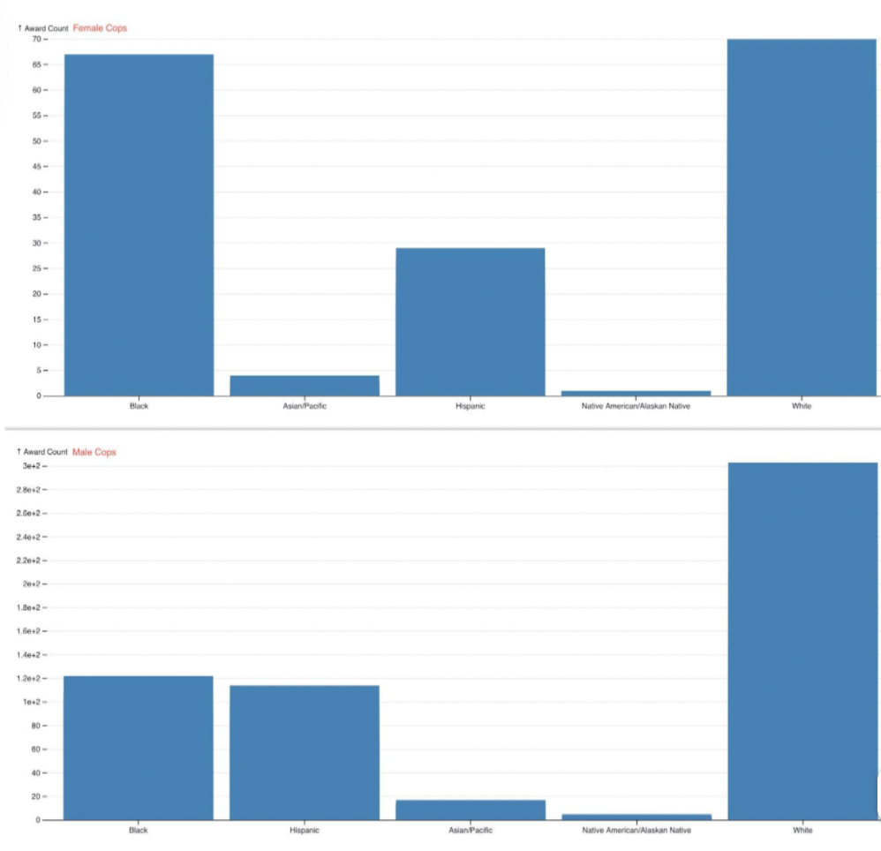
Award count distribution of Police Officers
Women are underrepresented as award winners in the majority of award categories.
Some exceptions where award-winning women police officers are comparable to that of men - Annual Bureau Award of Recognition, Attendance Recognition Award, and Complimentary Letter.

Slide 12
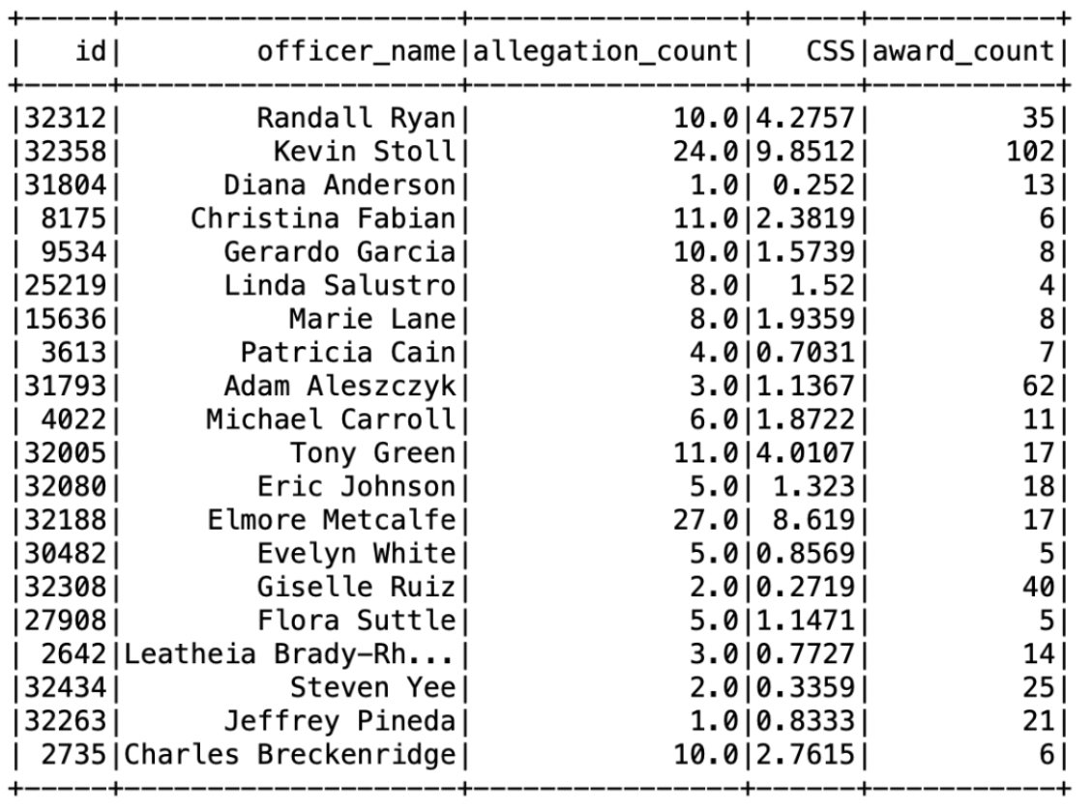
First Degree Connection of Police Officers
We build a graph network by selecting the nodes as police officers and their edges (relationship) defined by both officers being co-accused by the civilian.
Column ‘allegation_id’ in the table ‘data_officerallegation’ is used to create the edge.

Slide 13
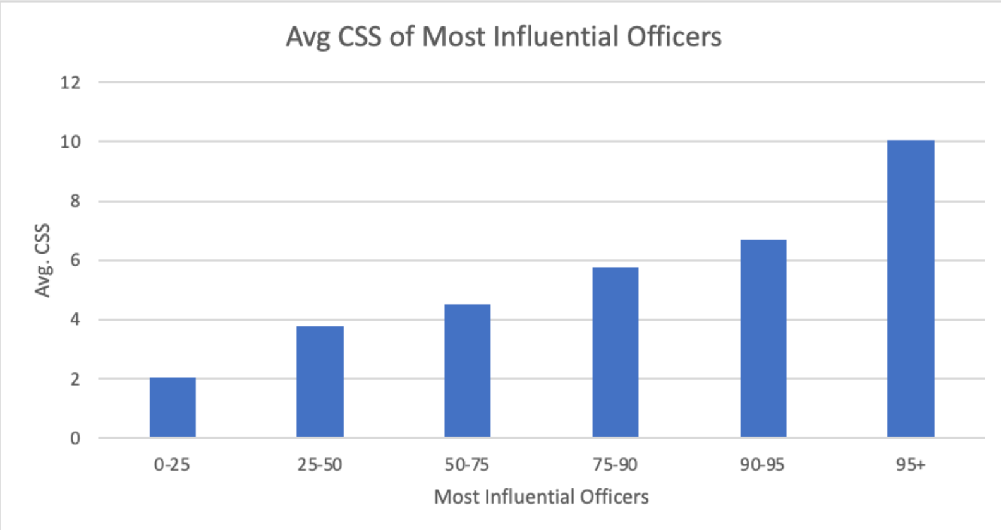
Graph Analytics - Most Influential Officers vs CSS

Slide 14
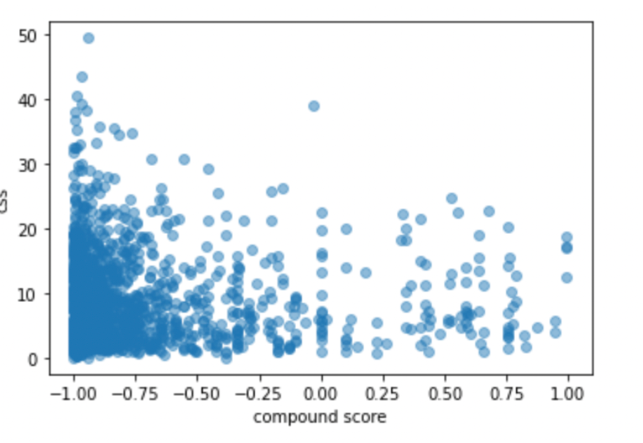
Natural Language Processing - Sentiment Analysis
Sentiment Analysis on allegation summary
Key Findings:
No correlation between polarity compound score and CSS
Linear regression analysis confirms this as P-value is higher than alpha

Slide 15
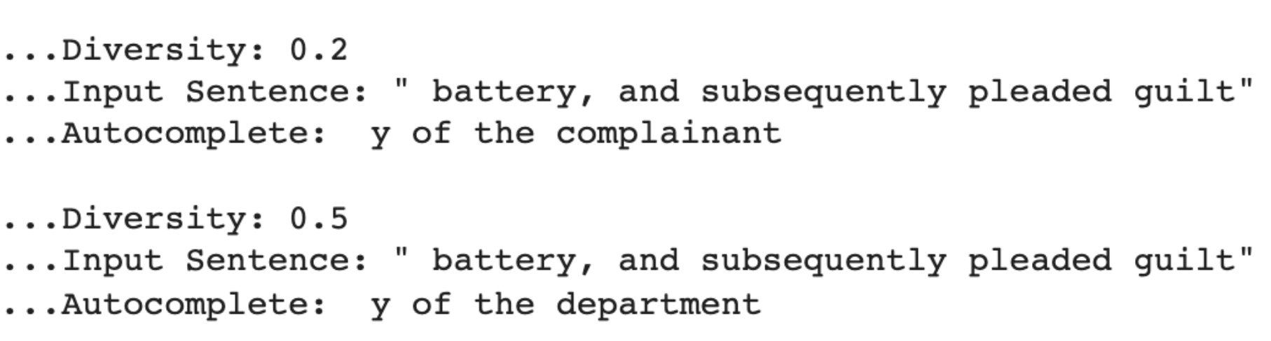
Natural Language Processing - Report AutoCompleter

